Slide 1
Hypercementosis, tumors, developmental abnormalities
Dr. Gábor Ackermann
www.fogaszati-radiologia.hu
gabor@dentesthic.hu

Slide 2
Tumors
Clinical examination
stomato-oncologic regular examination
Radiographic examination
Recognise (IO,OP)
Localise (occlusal)
Planning (CT, MRI, US, Nuclear medicine)

Slide 3
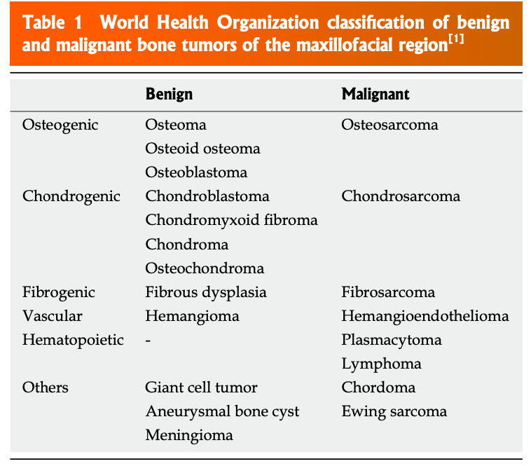
Imaging appearance of bone tumors of the maxillofacial region

Slide 4
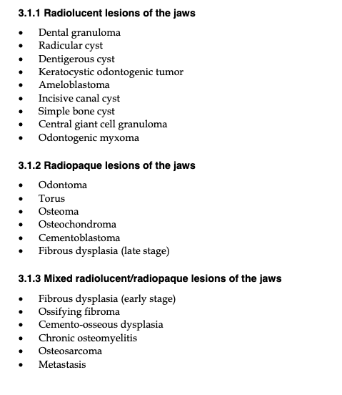
Diagnostic Imaging in Oral and Maxillofacial Pathology

Slide 5
Radiograchic examination (benigne tumor)
Localisation
origin
Borders
ovoid,
continous
Connecting tissue capsule, cortex
Inner structure
Effects of surroundings

Slide 6
Radiographic examination (benigne tumor)
Localisation
borders
Inner structure
Recognisable tissue
homogeneous/inhomogenous density
Effects on surroundings
not destroing

Slide 7
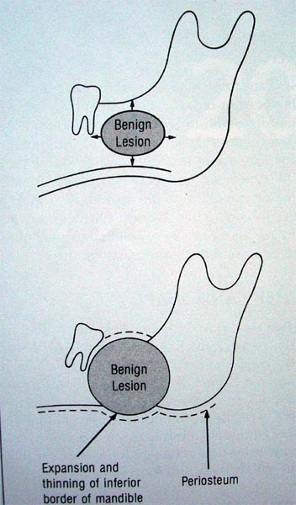
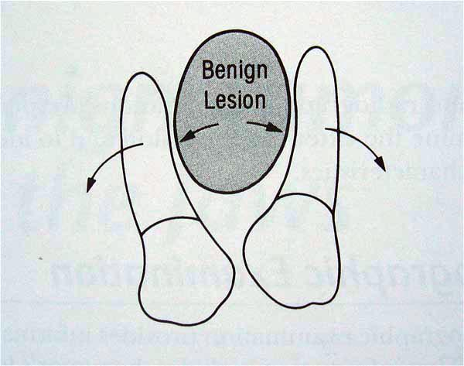

Slide 8
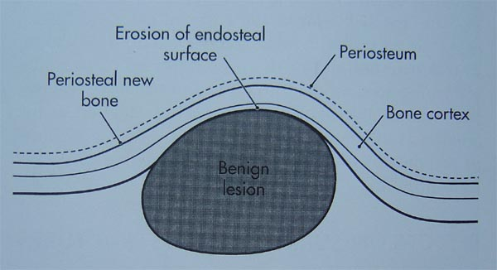

Slide 9
Benigne tumors
Real neoplasma (e.g. ameloblastoma)
Hamartoma (e.g. odontoma)
Hyerplasia
enostosis, exostosis, torus palatinalis, torus mandibularis, hypercementosis

Slide 10
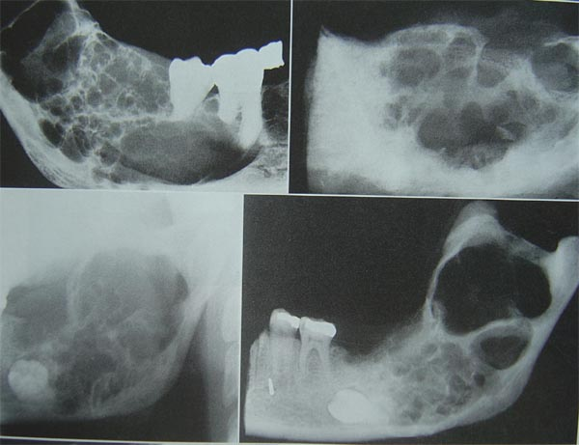
Ameloblastoma Real neoplasma

Slide 11
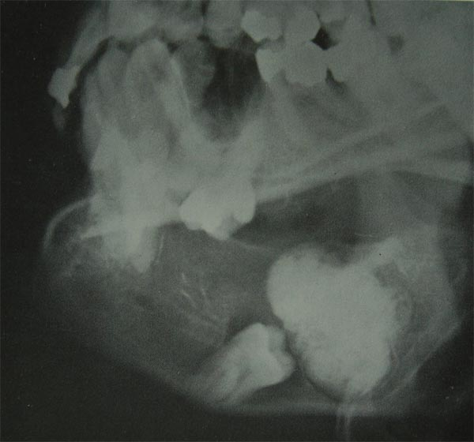
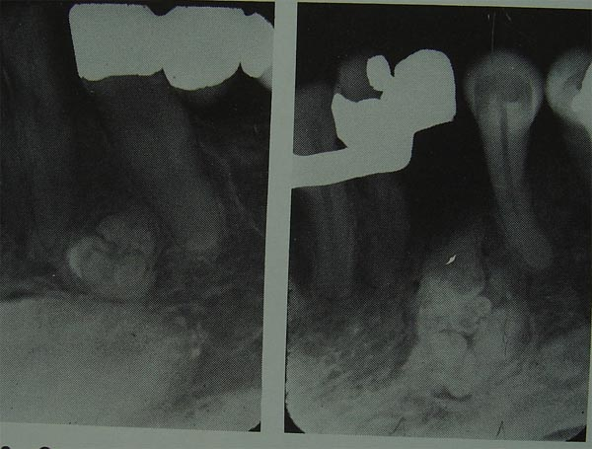
Odontoma Hamartoma
Complex Compound

Slide 12
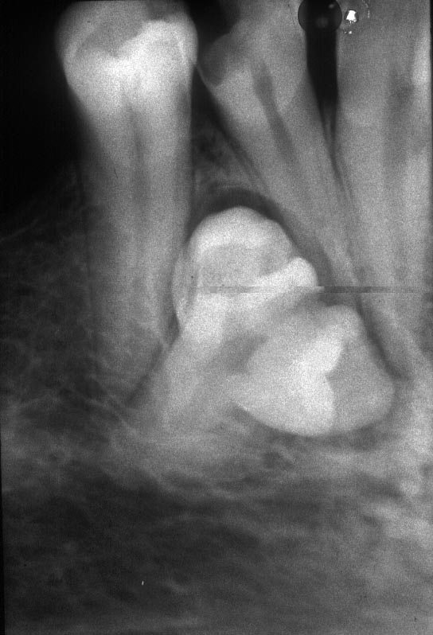
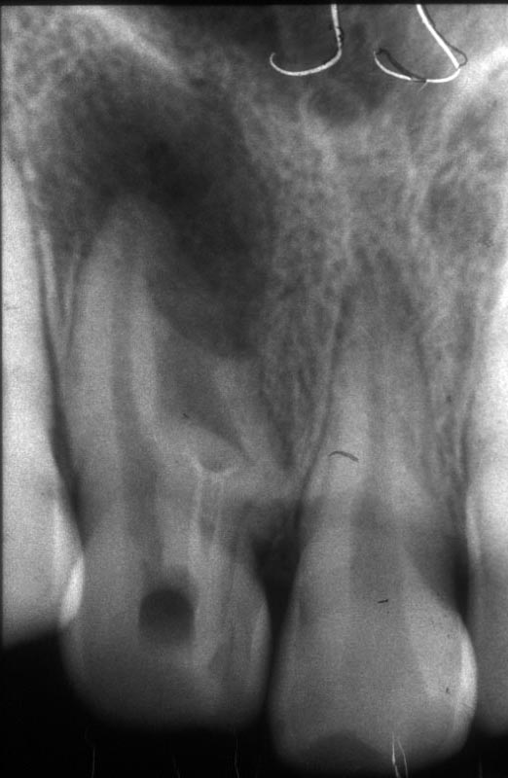
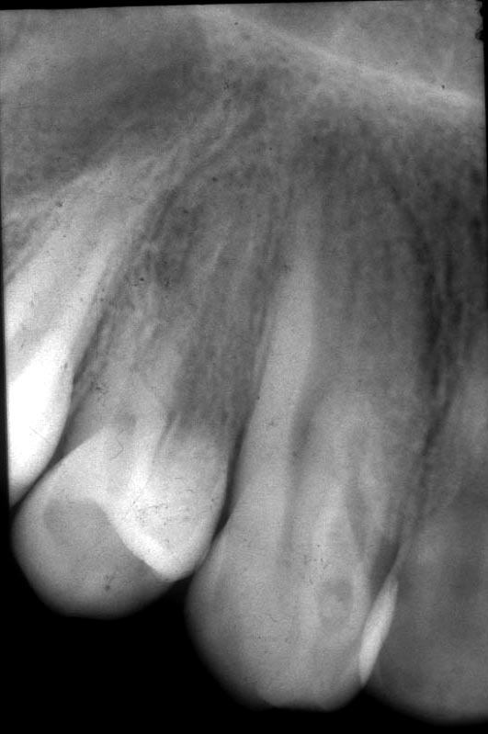
Odontoma
geminated dilated dens in dentem

Slide 13
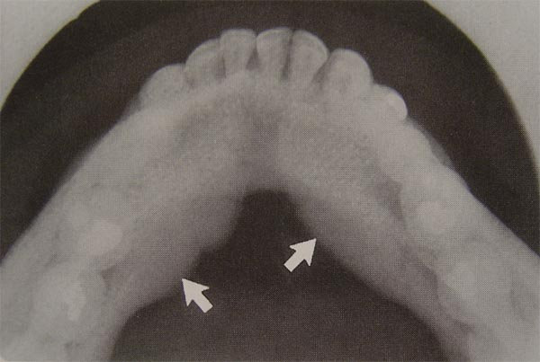
Torus mandibularis

Slide 14
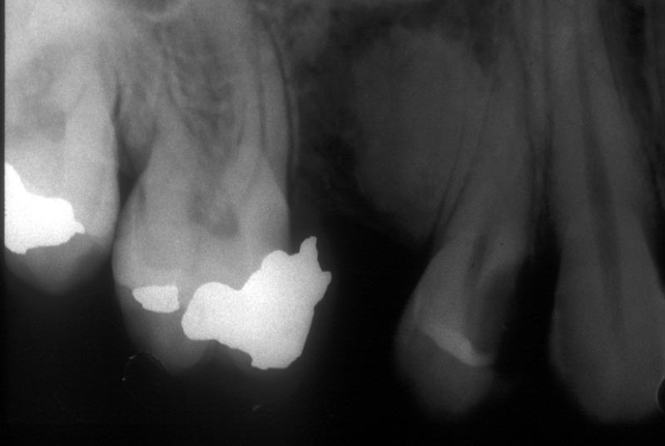
Enostosis

Slide 15
Hypercememtosis
On the apex:
Nonvital tooth, chr.inflammation
diffuse lateral:
overload
multiple:
Chr. Inflamm. of joints, general illnesses

Slide 16
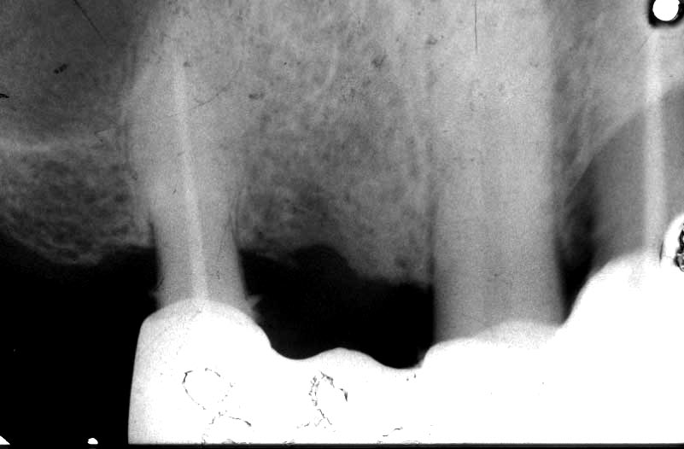

Slide 17
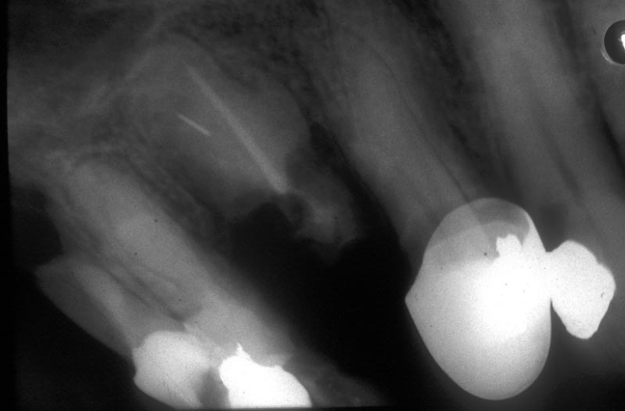

Slide 18
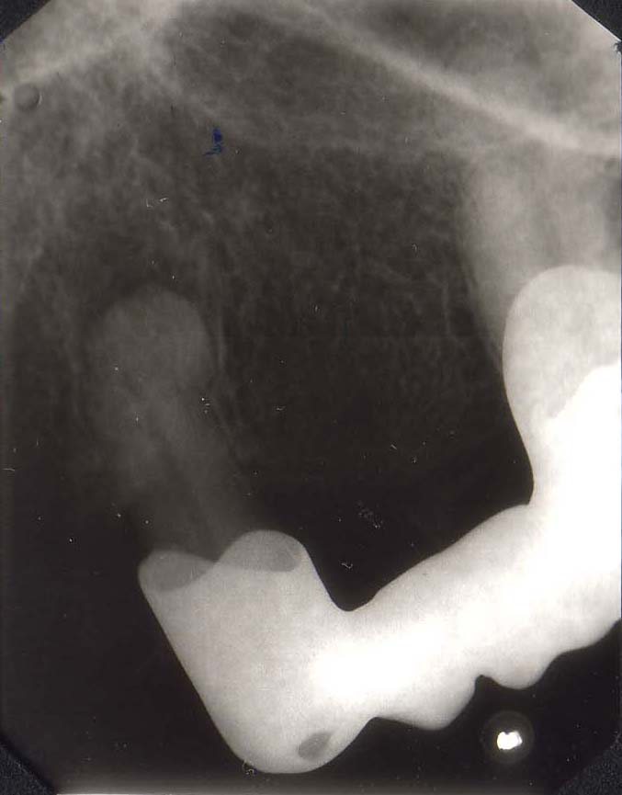

Slide 19
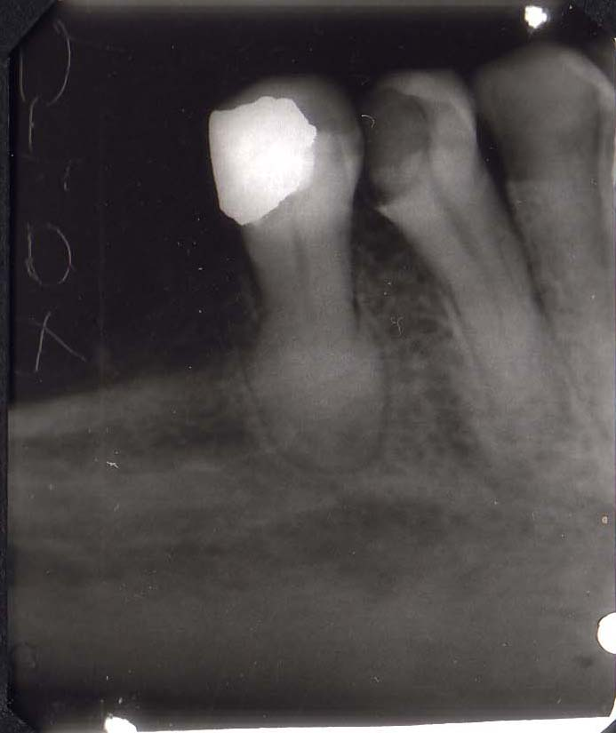

Slide 20
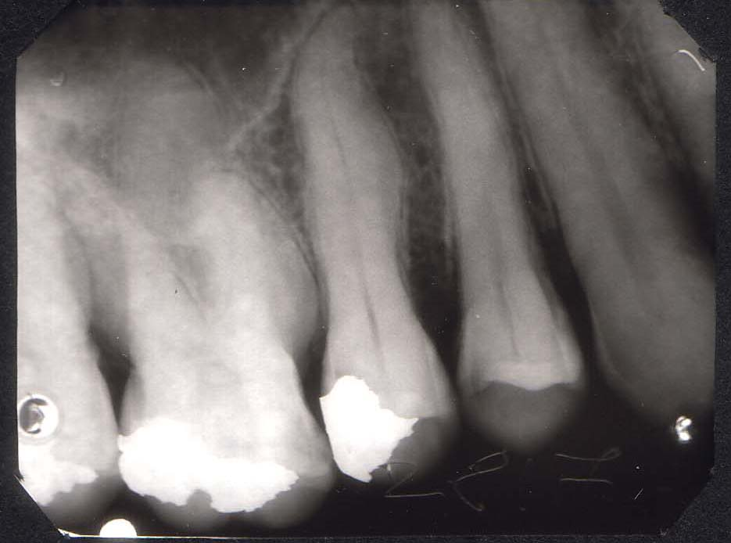

Slide 21
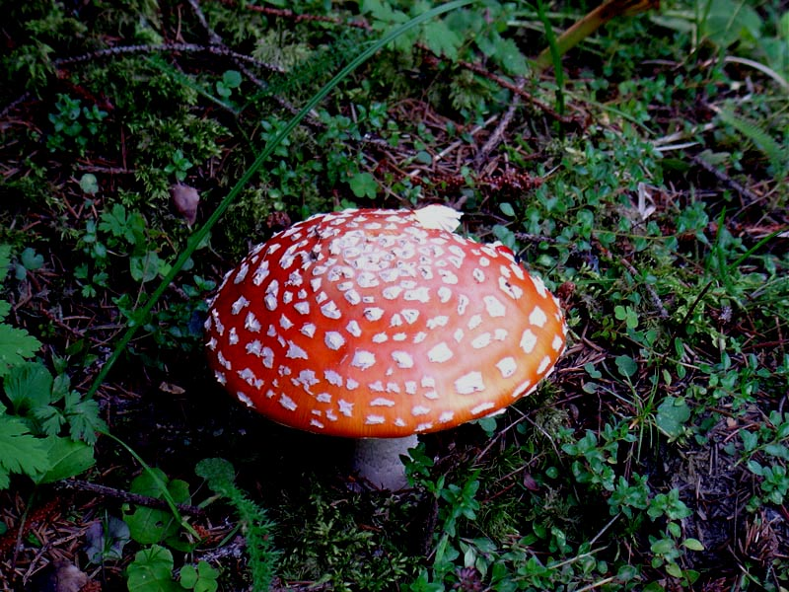

Slide 22
Radiographic examination (malignant tumor)
Localisation
Borders, shape
invasiv patern
no cortex, no connecting tissue capsule
Inner structure
Effects of surroundings

Slide 23
Radiographic examination (malignant tumor)
Localisation
borders
Inner structure
generally radiolucent
Bone islands
Effects on surroundings
quick, destructive effect

Slide 24
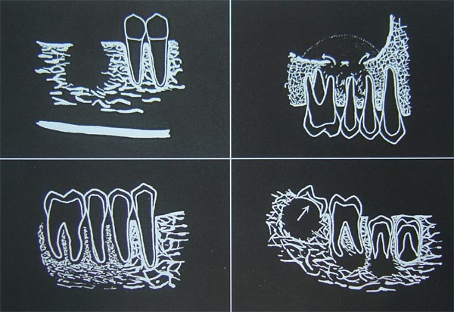

Slide 25
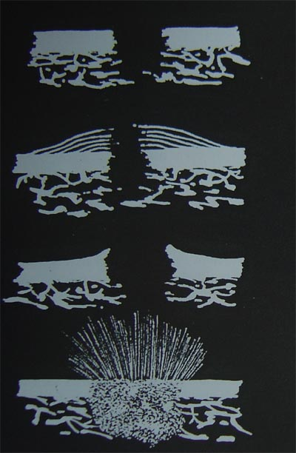
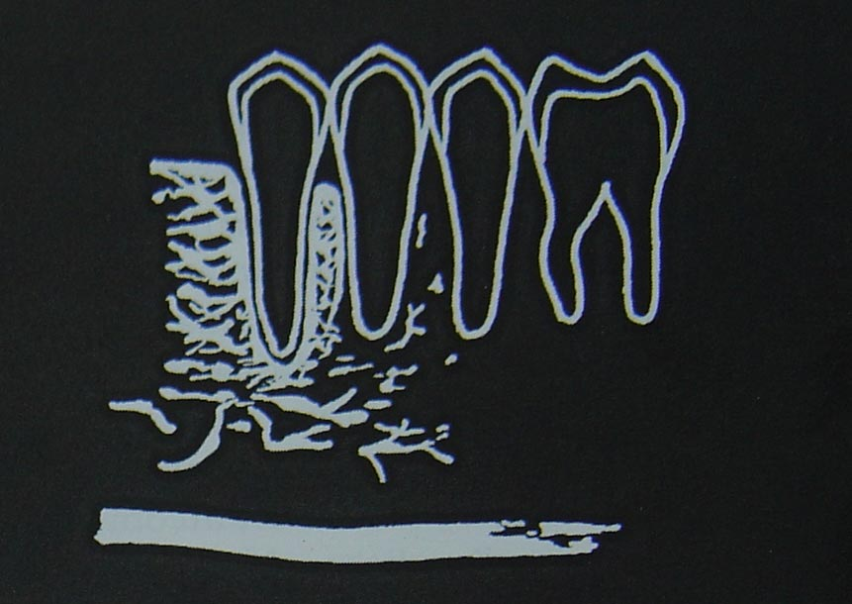

Slide 26
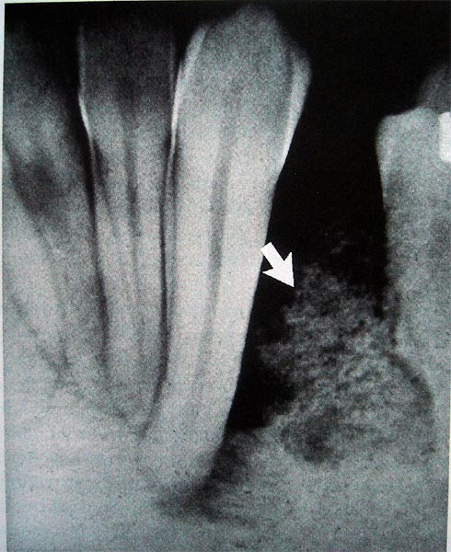
Osteosarcoma

Slide 27
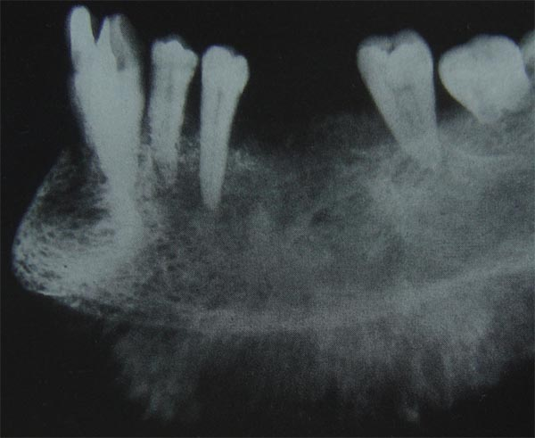

Slide 28
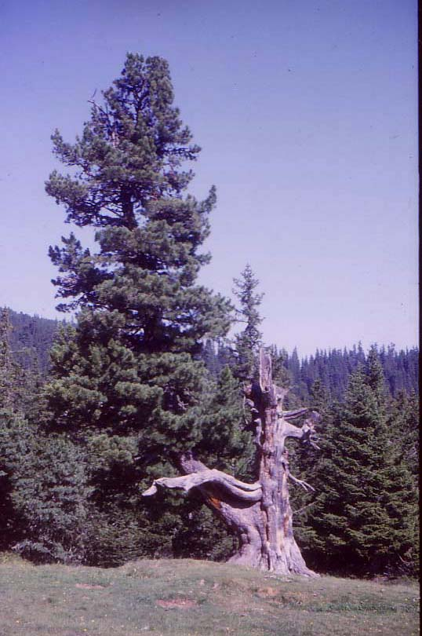

Slide 29
Dental anomalies
During development
On developed teeth, aquired
Localised
Generalised

Slide 30
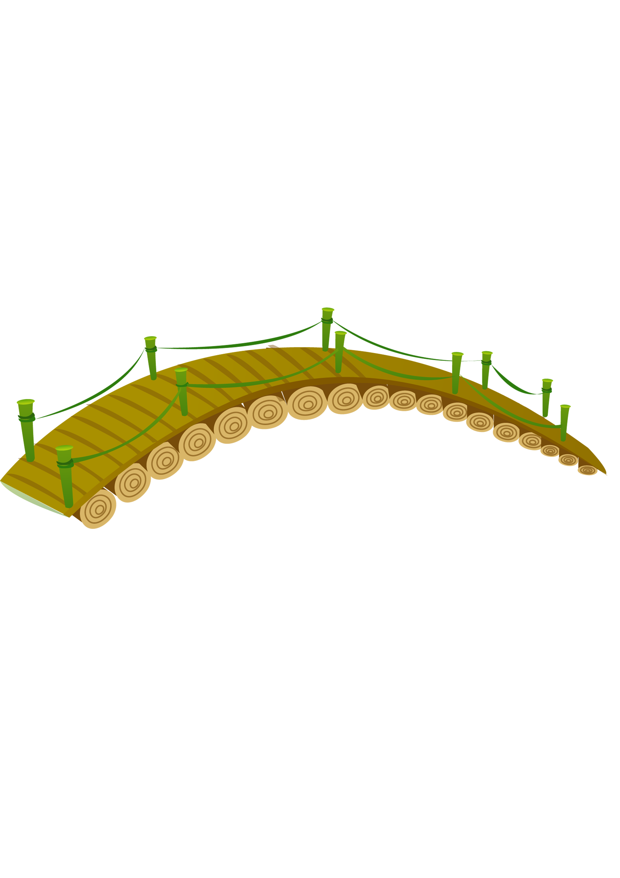
Complaints/symptoms
Healthy
Number
Shape
Misplaced
teeth
Size
Morphologic
alteration
Cleft
Abnormal
(Developmental
Abnormalities)
Pathologic

Slide 31
Dental anomalies
Size
Shape
Number
Misplaced teeth
Eruption
Morphologic alteration
Twin teeth
Cleft

Slide 32
Radiographic examination
Role:
Diagnosing
Treatment plan
Projections:
Intraoral
Panoramic
Advanced techniques (CBCT)

Slide 33
Size of teeth
Macrodontia
Microdontia
Nanismus dentium

Slide 34
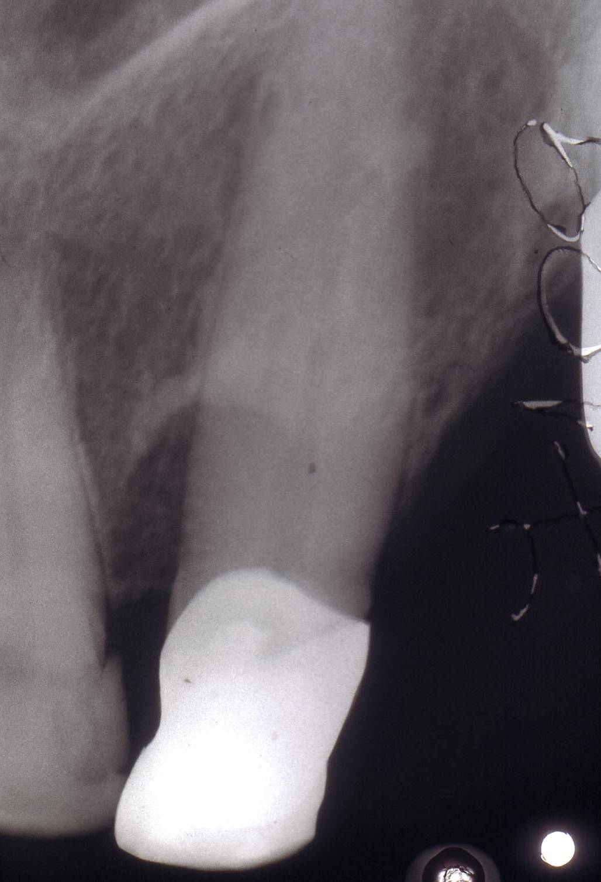
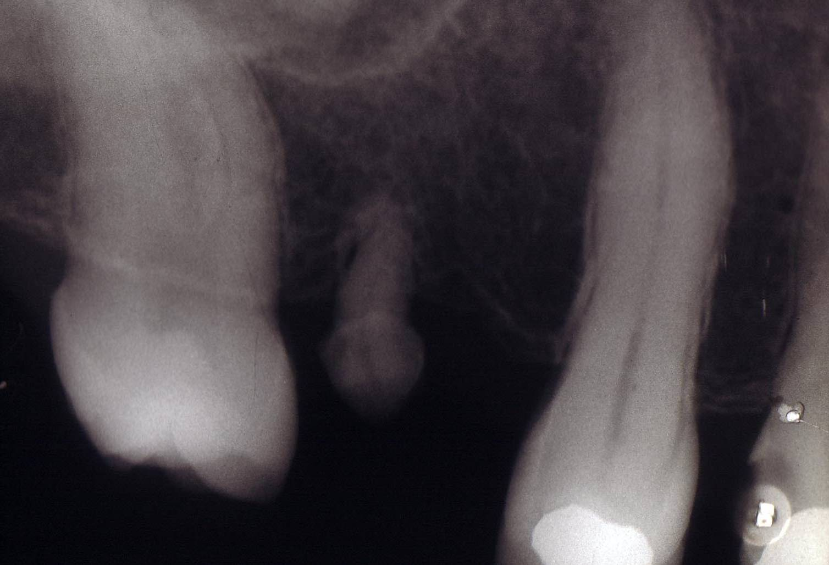
Macrodens Microdens

Slide 35
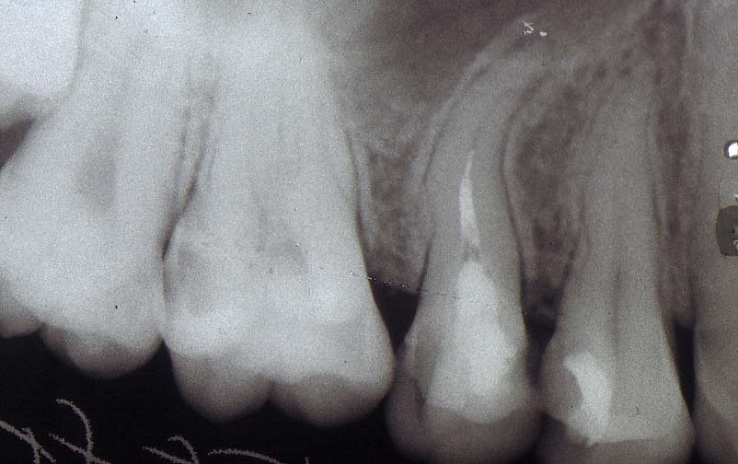
Shape of teeth, root

Slide 36
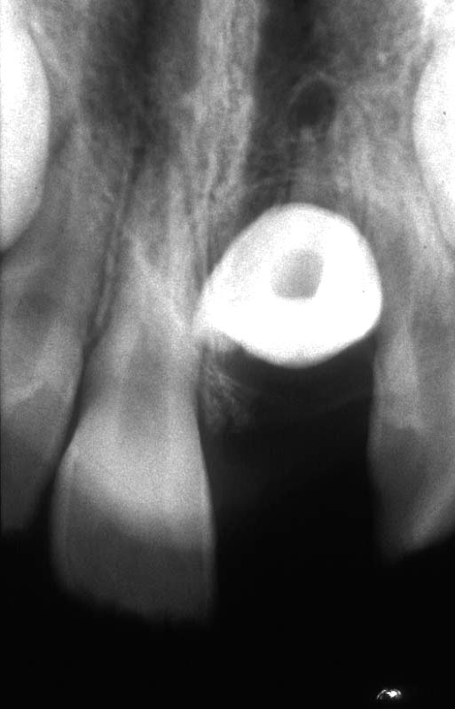
Dilaceration

Slide 37
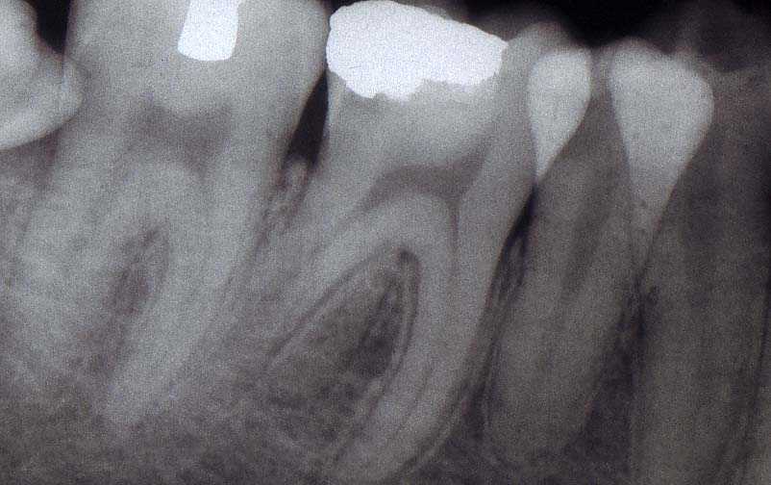
Number of roots

Slide 38
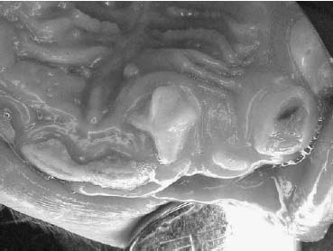
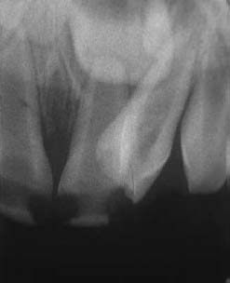

Slide 39
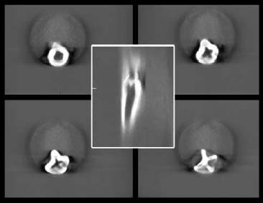

Slide 40
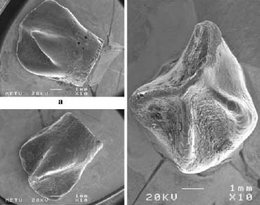

Slide 41
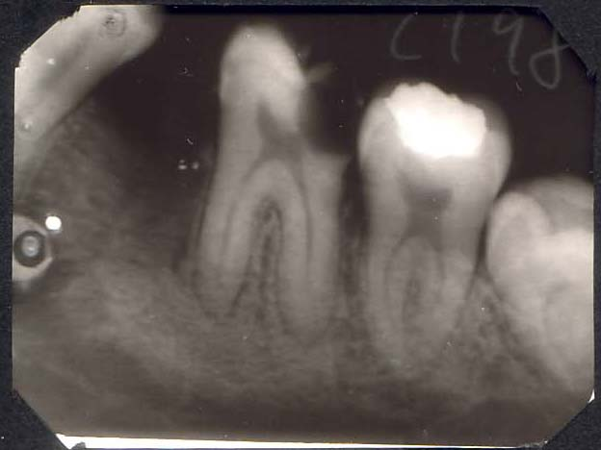
Taurodens

Slide 42
Abnormalities in number more teeth
Supernumerary tooth
Mesiodens
Paramolaris
Distomolaris
Suplementary tooth (normal shape)

Slide 43
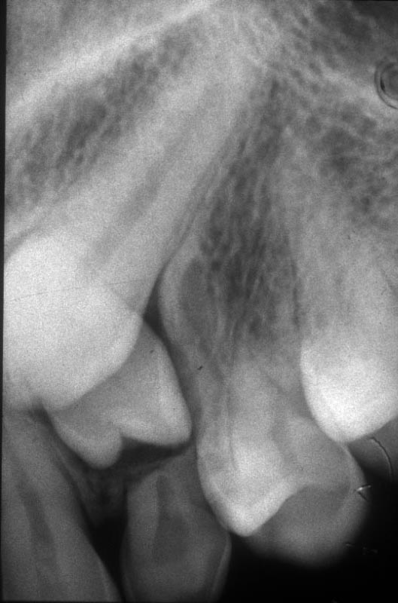

Slide 44
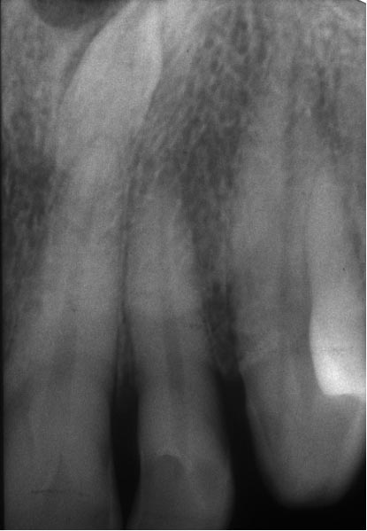

Slide 45
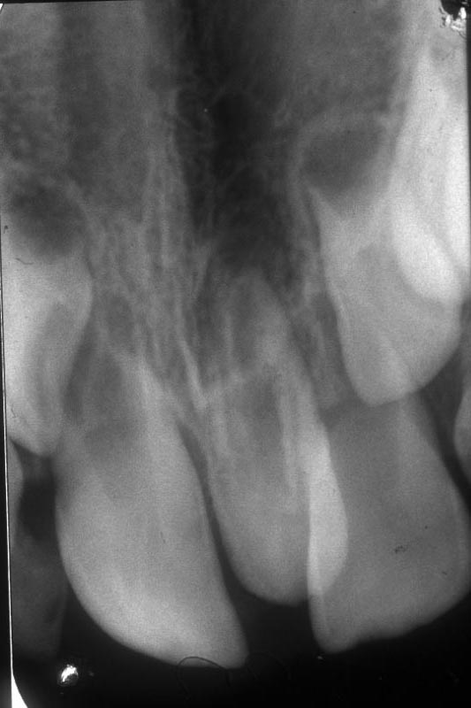

Slide 46
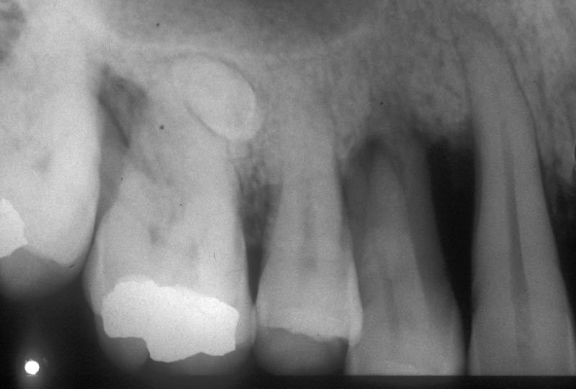

Slide 47
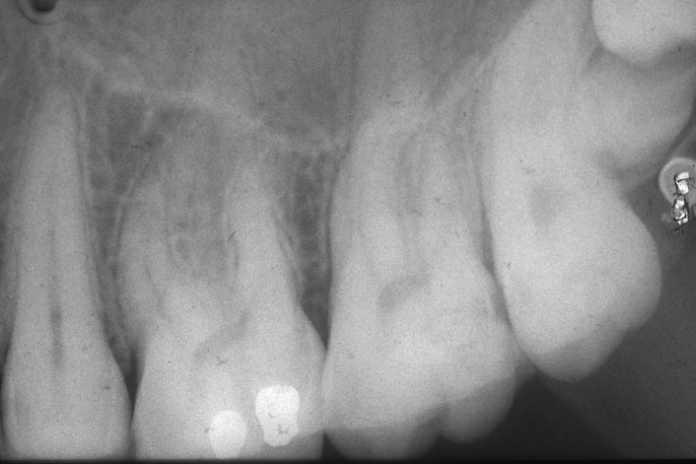

Slide 48
Abnormalities in number less teeth
Hypodontia spuria
Hypodontia vera
Oligodontia
Anodontia

Slide 49
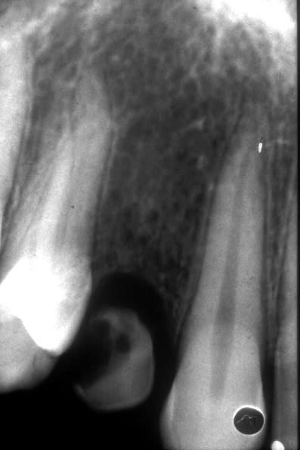

Slide 50
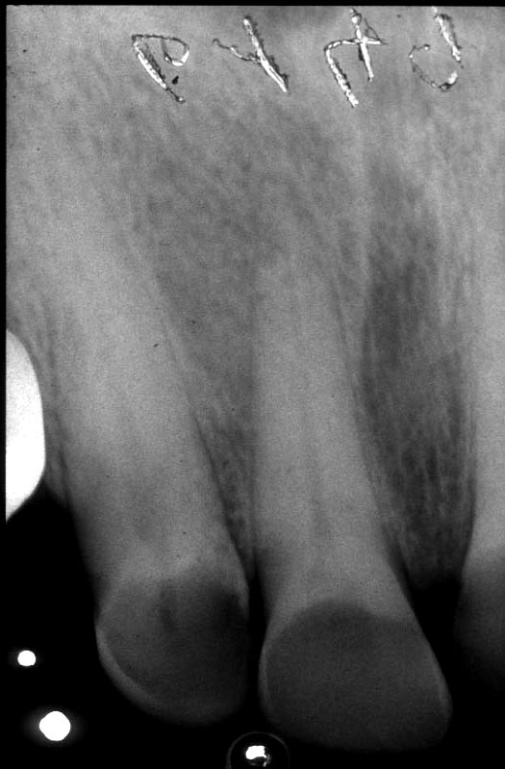

Slide 51
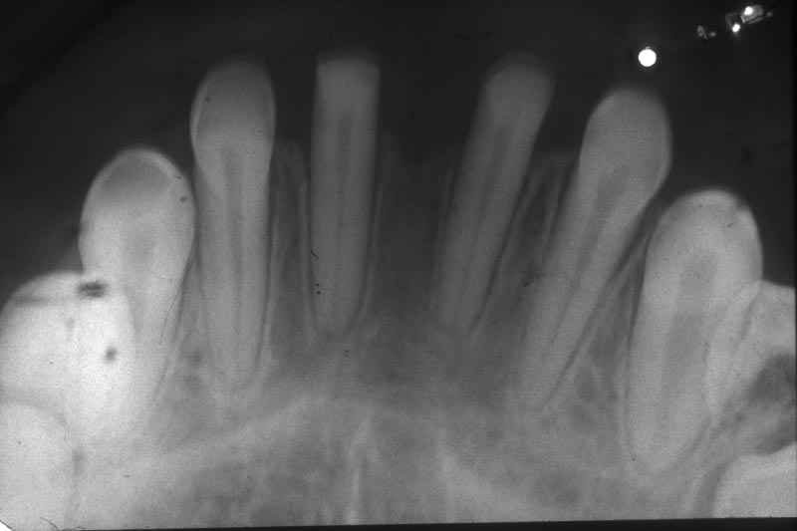

Slide 52
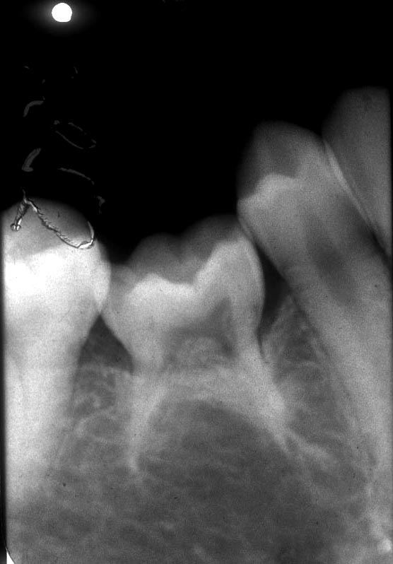

Slide 53
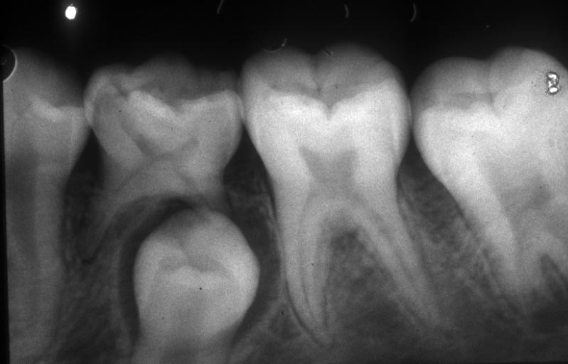

Slide 54
Unerupted teeth role of x-ray examination
Diagnose
Fact and extent
Number and location
Cause and consecvence
Treatment plan
Lokalisation
Anatomic landmarks

Slide 55
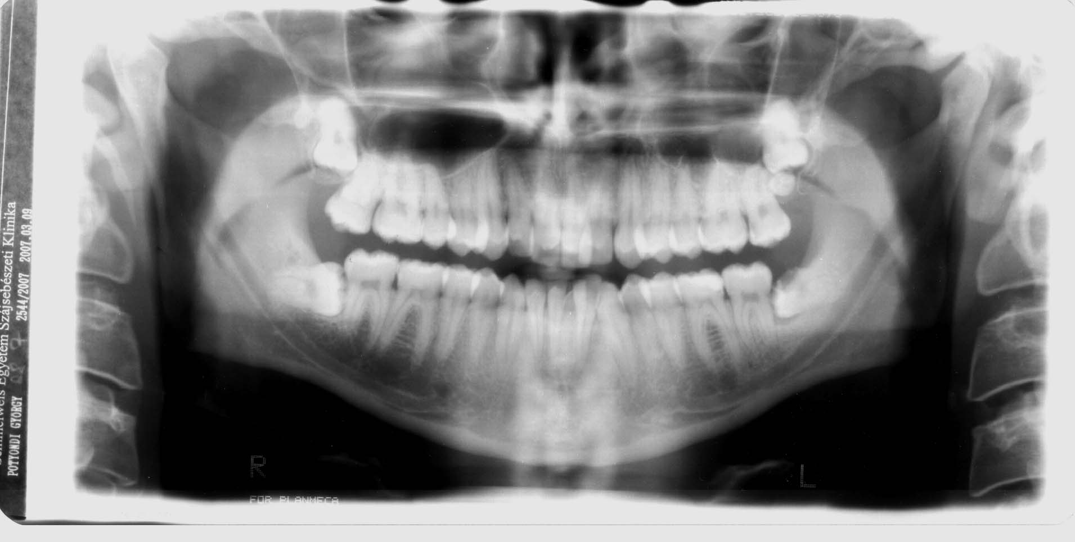

Slide 56
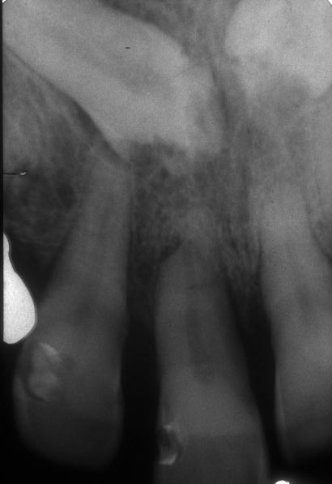

Slide 57
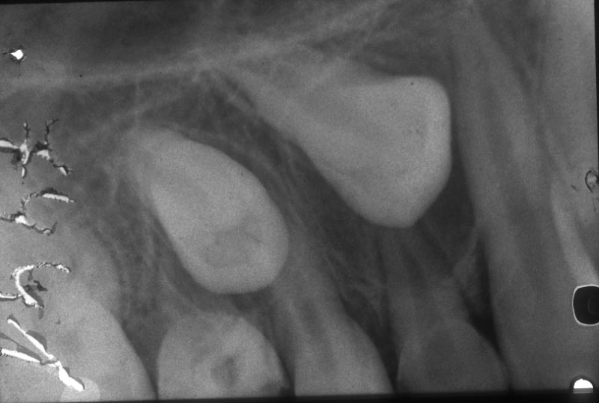

Slide 58
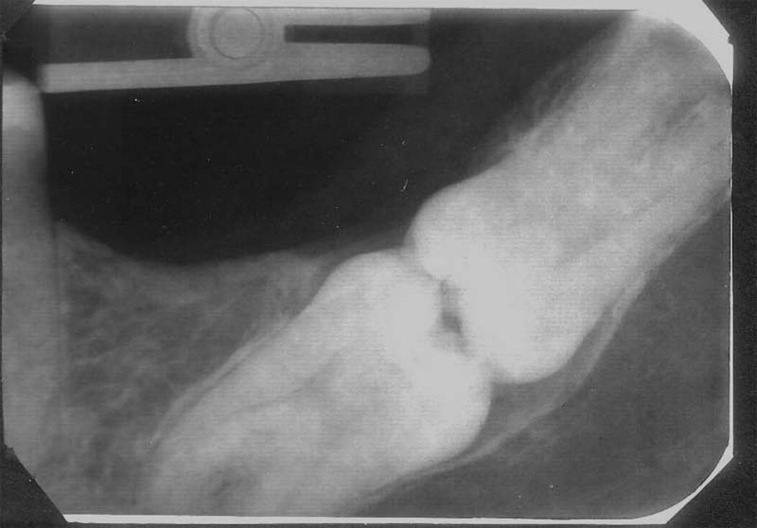

Slide 60
Localisation radiograms from different views
Using altered horisontal/vertical angulation
Buccalis object rule
Stereo radiograms
Radiograms perpendicular to each other
- periapical and occlusal
- advanced panoramic unites
Special imaging tools (CT, CBCT)

Slide 63
Cone Beam CT i-CAT (Imaging Sciences International)
www.dentesthic.hu/oktatas/

Slide 64
Sztereo scanogram
www.dentesthic.hu/oktatas/

Slide 65
Missplaced teeth
Distalisatio
Rotatio, torsio
Intra-, extraversio
Supra-, infraocclusio
Transpositio
Heterotopia

Slide 72
Altered morphology
Amelogenesis imperfecta Enamel hypoplasia

Slide 73
Dentinogenesis imperfecta

Slide 74
Twin teeth
Geminatio Fusio

Slide 75
Thank you for your attention

